Slide 1
Software Construction & Development
Week 09
Abeeha Sattar

Slide 2
JavaFX

Slide 3
What is JavaFX?
JavaFX is a Java library used to develop Desktop applications as well as Rich Internet Applications (RIA). The applications built in JavaFX, can run on multiple platforms including Web, Mobile and Desktops.

Slide 4
Features of JavaFX
Java Library | It is a Java library which consists of many classes and interfaces that are written in Java.
FXML | FXML is the XML based Declarative mark up language. The coding can be done in FXML to provide the more enhanced GUI to the user.
Scene Builder | Scene Builder generates FXML mark-up which can be ported to an IDE.
Web view | Web pages can be embedded with JavaFX applications. Web View uses WebKitHTML technology to embed web pages.
Built in UI controls | JavaFX contains Built-in components which are not dependent on operating system. The UI component are just enough to develop a full featured application.
CSS like styling | JavaFX code can be embedded with the CSS to improve the style of the application. We can enhance the view of our application with the simple knowledge of CSS.
Swing interoperability | The JavaFX applications can be embedded with swing code using the Swing Node class. We can update the existing swing application with the powerful features of JavaFX.
Canvas API | Canvas API provides the methods for drawing directly in an area of a JavaFX scene.
Rich Set of APIs | JavaFX provides a rich set of API's to develop GUI applications.
Integrated Graphics Library | An integrated set of classes are provided to deal with 2D and 3D graphics.
Graphics Pipeline | JavaFX graphics are based on Graphics rendered pipeline(prism). It offers smooth graphics which are hardware accelerated.
High Performance Media Engine | The media pipeline supports the playback of web multimedia on a low latency. It is based on a Gstreamer Multimedia framework.
Self-contained application deployment model | Self Contained application packages have all of the application resources and a private copy of Java and JavaFX Runtime.

Slide 5
XML Technology
XML = Extensible Markup Language
Derived from SGML (Standard Generalized Markup Language)
Text-based format
Describes document structures using markup tags
Useful for describing document formats for Web
It is also useful for describing both structured as well as semi-structured data.

Slide 6
Integrating JavaFX with Eclipse
You can follow this tutorial:
https://www.javatpoint.com/javafx-with-eclipse
Remember that you also need the JRE along with the JDK!

Slide 7
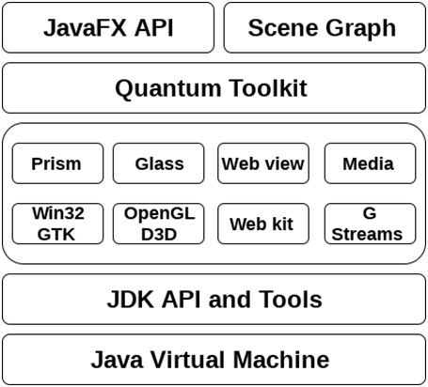
JavaFX Architecture

Slide 8
JavaFX Architecture
JavaFX public API which provides all the necessary classes that are responsible for executing a full featured JavaFX application
SceneGraph is the starting point of constructing a JavaFX application. It is a hierarchical tree of nodes that represent all the visual elements of user interface. It also has the capability of event handling.
The JavaFX Graphics Engine provides the graphics support to the scene graph. It basically supports 2D as well as 3D graphics.
Prism can be seen as High Performance hardware-accelerated graphics pipeline. It has the capability to render both 2D and 3D graphics. (DirectX 9, DirectX 11, OpenGL, Java 2D)
Glass Windowing Toolkit is present on the lowest level of JavaFX graphics stack. It basically can be seen as a platform dependent layer which works as an interface between JavaFX platform and native operating system.
Quantum Toolkit is used to bind prism and glass windowing tool kit together and makes them available for the above layers in stack.
Notes:
Java 2D only if hardware acceleration is unavailable.

Slide 9
JavaFX Architecture
We can embed the HTML content to a JavaFX scene graph by using the Web View component.
Web view uses web kit which is an internal open source browser and can render HTM5, DOM, CSS, SVG and JavaScript.
The JavaFX application can support the playback of audio and video media files by using Media Engine.
JavaFX media engine depends upon an open source engine called as G Streamer.

Slide 10
JavaFX Application Structure
JavaFX application is divided hierarchically into three main components:
Stage
Scene
Nodes
All JavaFX applications inherit from Application. It has the following methods:
public void init()
public abstract void start(Stage primaryStage)
public void stop()
Notes:
You have to override the start method, as it is abstract.

Slide 11
Stage
Stage in a JavaFX application is similar to the Frame in a Swing Application. It acts like a container for all the JavaFX objects.
Other stages can further be created by the application.
We need to call show() method on the primary stage object in order to show our primary stage. Initially, it would appear as an empty window.
You can add other objects to it afterwards.

Slide 12
Scene
It holds all the nodes of the JavaFX Application.
Javafx.scene.Scene class provides all the methods to deal with a scene object.
Creating Scene is necessary in order to visualize the contents on the Stage.
A Stage can hold only one Scene object at any point.

Slide 13
Scene Graph
Scene Graph exists at the lowest level of the hierarchy.
It can be seen as the collection of various nodes.
A node is the element which is visualized on the stage. It can be any:
button,
text box,
layout,
image,
radio button,
check box, etc.

Slide 14
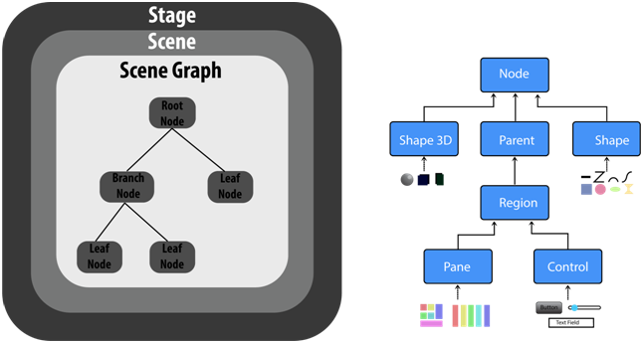
Stage, Scene & Scene Graph
Notes:
The nodes are implemented in a tree kind of structure. There is always one root in the scene graph.
This will act as a parent node for all the other nodes present in the scene graph.
However, this node may be any of the layouts available in the JavaFX system.

Slide 15
Skeleton : JavaFX Application
import javafx.application.Application;
import javafx.stage.Stage;
public class Hello_World extends Application{
@Override
public void start(Stage primaryStage) throws Exception {
// TODO Auto-generated method stub
}
}

Slide 16
Following things are Imported:
import javafx.application.Application;
import javafx.event.ActionEvent;
import javafx.event.EventHandler;
import javafx.scene.Scene;
import javafx.scene.control.Button;
import javafx.stage.Stage;
import javafx.scene.layout.StackPane;

Slide 17
The Start Method
public void start(Stage primaryStage) throws Exception { Button btn1=new Button("Say, Hello World"); btn1.setOnAction(new EventHandler<ActionEvent>() { @Override public void handle(ActionEvent arg0) { System.out.println("hello world"); } }); StackPane root=new StackPane(); root.getChildren().add(btn1); Scene scene=new Scene(root,600,400); primaryStage.setScene(scene); primaryStage.setTitle("First JavaFX Application"); primaryStage.show(); }
Notes:
Stackpane is a layout
Scene holds the root (tree/nodes)
Stage holds Scene
JavaFX has its own event handler

Slide 18
The Main Method
public static void main (String[] args) {
launch(args);
}

Slide 19
Fin.

